Slide 1
UDP Echo Client Server Communication

Slide 2
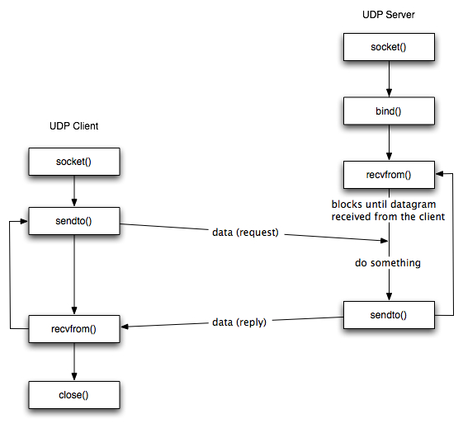

Slide 3
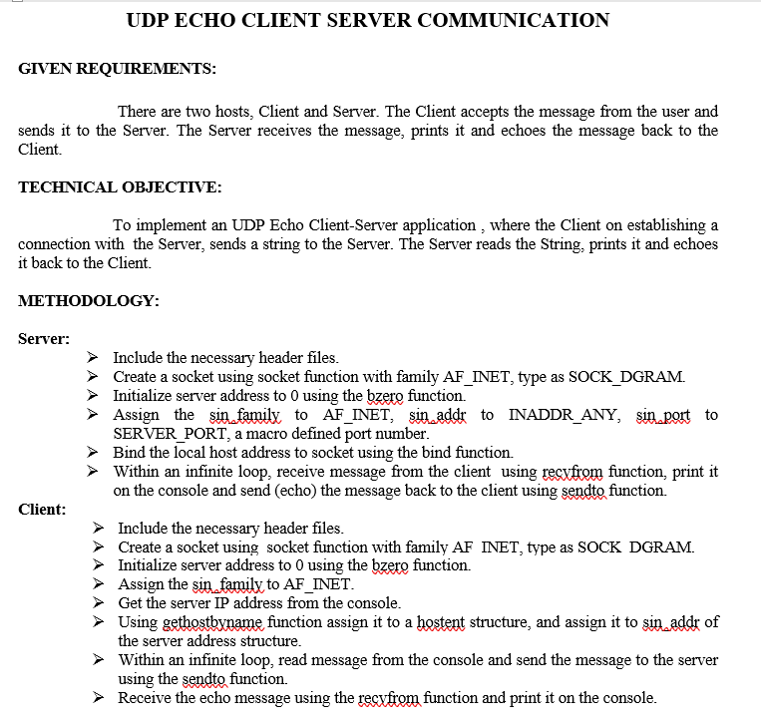

Slide 4
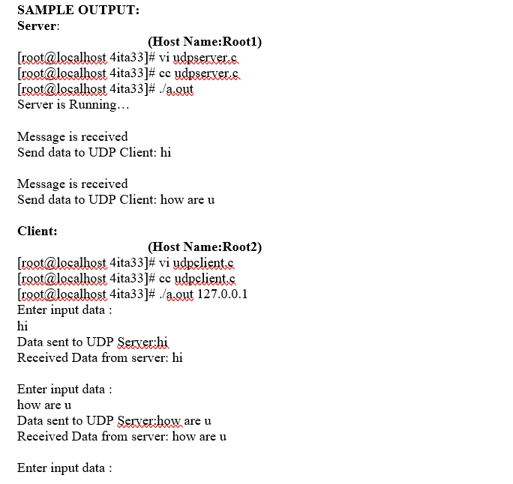
INFERENCE:
Thus, the UDP ECHO client server communication is established by sending the message from the client to the server and server prints it and echoes the message back to the client.

